Slide 1
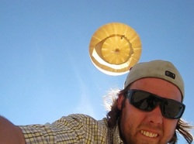
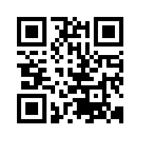
Aaron Weiss (Physics BA)
Prototype Engineer
Sparkfun Electronics — Boulder, CO
You might call Aaron Weiss an adventurer. After earning his BA in physics, he went through three jobs before he saw his true potential:
“It was a scrappy group of engineers cooking circuit boards in a tiny room with no ventilation.”
Aaron testing his high altitude balloon flight computer, one of his many projects.
Since then, Aaron has designed pieces of embedded hardware, written code, and fabricated circuit boards at Sparkfun, Inc., a company that builds hardware components for use in electronics projects. He even started his own company, called Bitsmashed.
At Bitsmashed, Aaron has built everything from geiger counters to a GPS backpack strapped to a live hawk!! He says that his physics training has helped him blaze his own career path:
“When I grasped how complex our world is, my curiosity shot through the roof. I knew I could learn [what I needed] as I went along”.
Learn more: www.bitsmashed.com

Slide 2
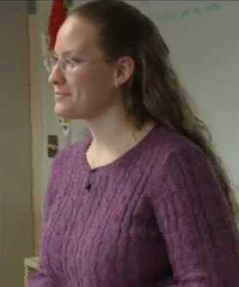
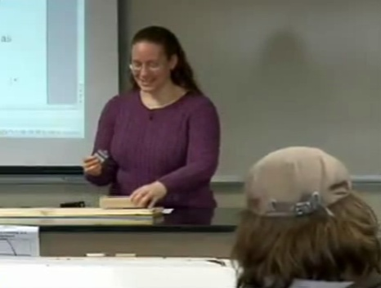
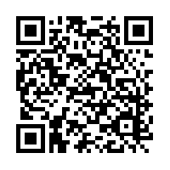
Mary Lee McJimsey (Physics BSc)
High School Physics Teacher North Central High School – Spokane, WA
Attend Mary Lee McJimsey’s high school physics class, and you may be surprised!
Rather than delivering a long lecture at the board, she would be leading students in a hands-on exploration of how physics principles appear in everyday situations.
In addition to teaching, Mary Lee works with a physics education researcher who collects data on how students learn in her classes.
“It’s important for teachers to be well-versed in physics education research,” she says. “My understanding of this research informs the methods I use in my classroom.”
Mary Lee in action in her high school physics class!

Slide 3
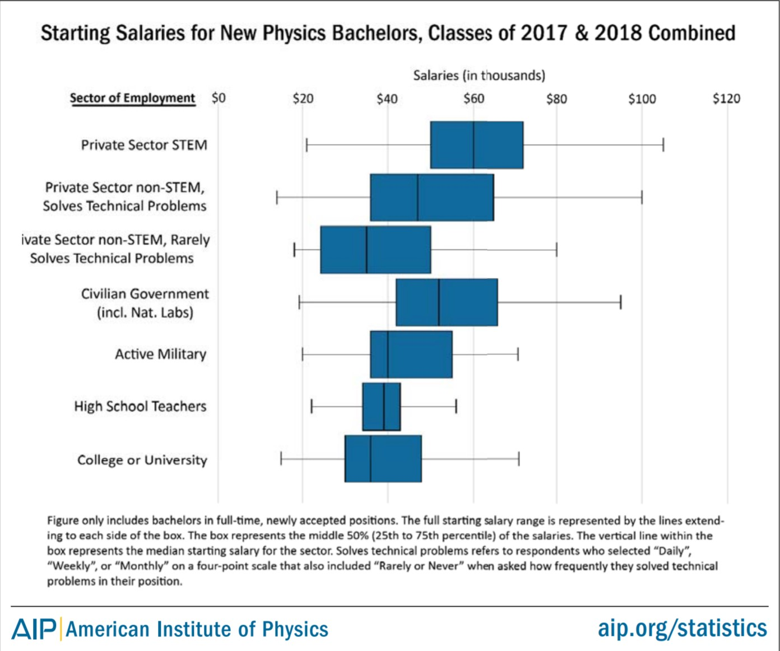
Did You Know?
How Much a Physics BSc Pays
In 2009 and 2010, over half of physics bachelors who went to work were in private sector jobs.
The majority of these were in STEM areas—making between $50 - $70K!
These bachelors were also working primarily in engineering and computer science jobs.
Learn more: aip.org/statistics
Credit: based on Physics Insight slide from the APS

Slide 4
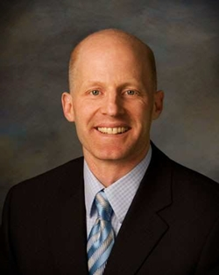
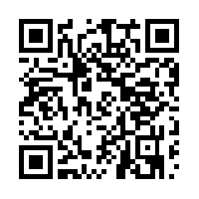
Brent Wouters (Physics BSc)
Executive Vice President IO Data Centers – Phoenix, AZ
Growing up in Iowa, Brent felt that math and science always came easily to him. Once in college, he chose to major in Physics because of its versatility:
“[Physics] would provide a technical foundation that would allow me to pursue whatever I wanted,” he says.
After graduating, Brent got his MS in Aerospace Engineering and embarked on quite a journey, working as an aircraft engineer at Lockheed Martin, earning an MBA, and eventually becoming CFO and CEO of Cirrus Aircraft, a company that builds planes.
Today, as Executive Vice President of IO Data Centers, a corporation that manages computer data centers for companies all around the world, Brent attributes his success in so many different areas to his Physics training:
“You’ve got to recognize that your career will take you in a host of directions,” he says. “Physics [will open] a tremendous number of doors.”

Slide 5
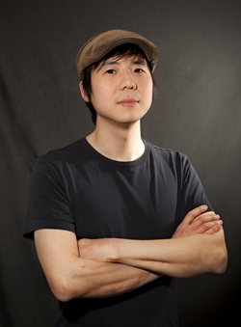
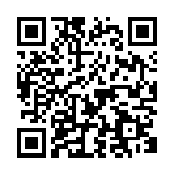
Yung Tae Kim (Physics PhD) Physicist and Educator Puget Sound Community School – Seattle, WA
Why Physics?
Tae, who enjoyed mathematics in high school, signed up for an honors physics class in college. The class only had 8 students and a great professor.
“[The physics class] was personalized, and it had a huge impact on me.”
Tae became a physics professor, but wanted to keep that personalized dynamic alive for his students. He turned his advanced classes into workshops.
Eventually, Tae became a consultant in video games, providing his skateboarding physics expertise to titles such as Tony Hawk: SHRED and RIDE.
Now, he serves on the advisory board for a community school geared toward learning at the student’s pace.
Clayton Hauck
“I don’t have a ‘career’ – I work on things that I find interesting, and my training in science has given me that adaptability.”

Slide 6
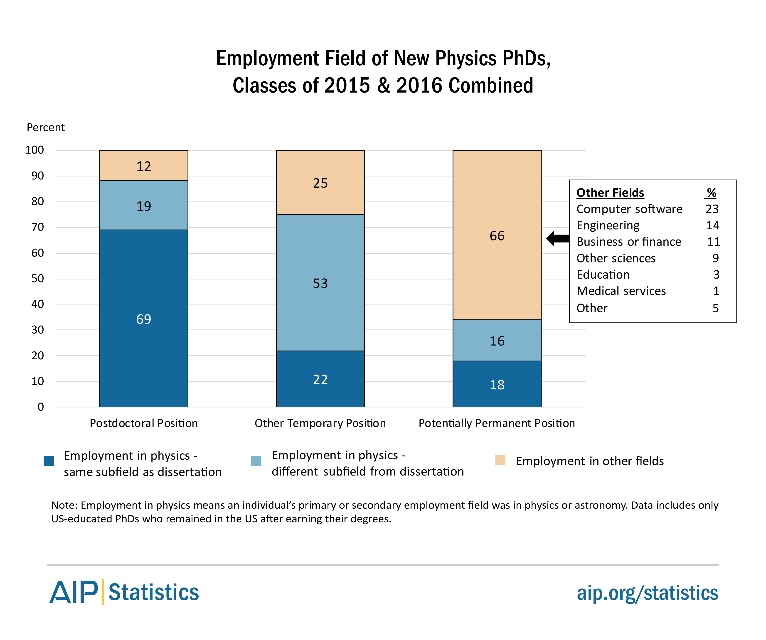
Did You Know?
Physics PhDs Can Also Be Engineers!
In 2009-2010, physics PhDs initially employed in permanent positions earned up to 100K
Over half of these found employment working in fields other than Physics.
In fact, many of them were employed in Engineering or Computer Software Jobs
A Physics PhD leads to many different career paths
Learn more: aip.org/statistics
Credit: based on Physics Insight slide from the APS

Slide 7
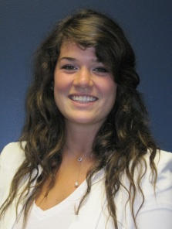
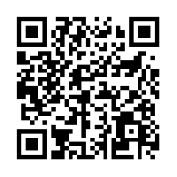
Maggie Seeds (Physics BSc)
Associate Consultant
Clarkston Consulting – Durham, NC
Maggie was always a stargazer, and that interest in astronomy drew her to study physics in college. She researched young solar analogs – distant stars similar to our own sun as it formed, long ago. Maggie also enjoyed the satisfaction of finding an answer to complicated problems.
"My physics background helped train my brain to think analytically, and persevere through tough situations."
Today, Maggie is an associate consultant for a management and technology consulting firm. She plays many different roles depending on clients’ needs, ranging from technical to strategic plans regarding how raw materials make their way into a finished marketable product.
“I wanted a career that allowed me to use the critical thinking skills gained from my physics studies to solve complex business problems.”

Slide 8
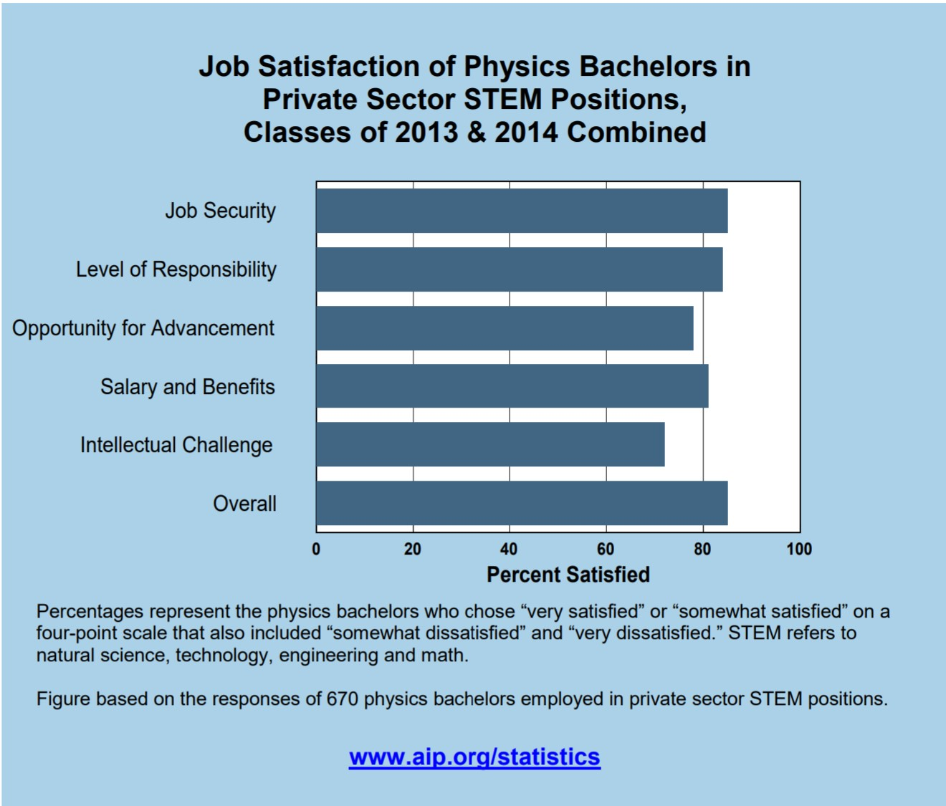
Did You Know?
Physics Bachelors Have Successful Careers!
In times of economic instability, job security is important.
82%
Other important job aspects—such as salary and benefits—rank highly among physics bachelor graduates working in the private sector.
Many physics bachelors go on to enjoy financially rewarding and intellectually stimulating careers
Learn more: aip.org/statistics
Credit: based on Physics Insight slide from the APS

Slide 9
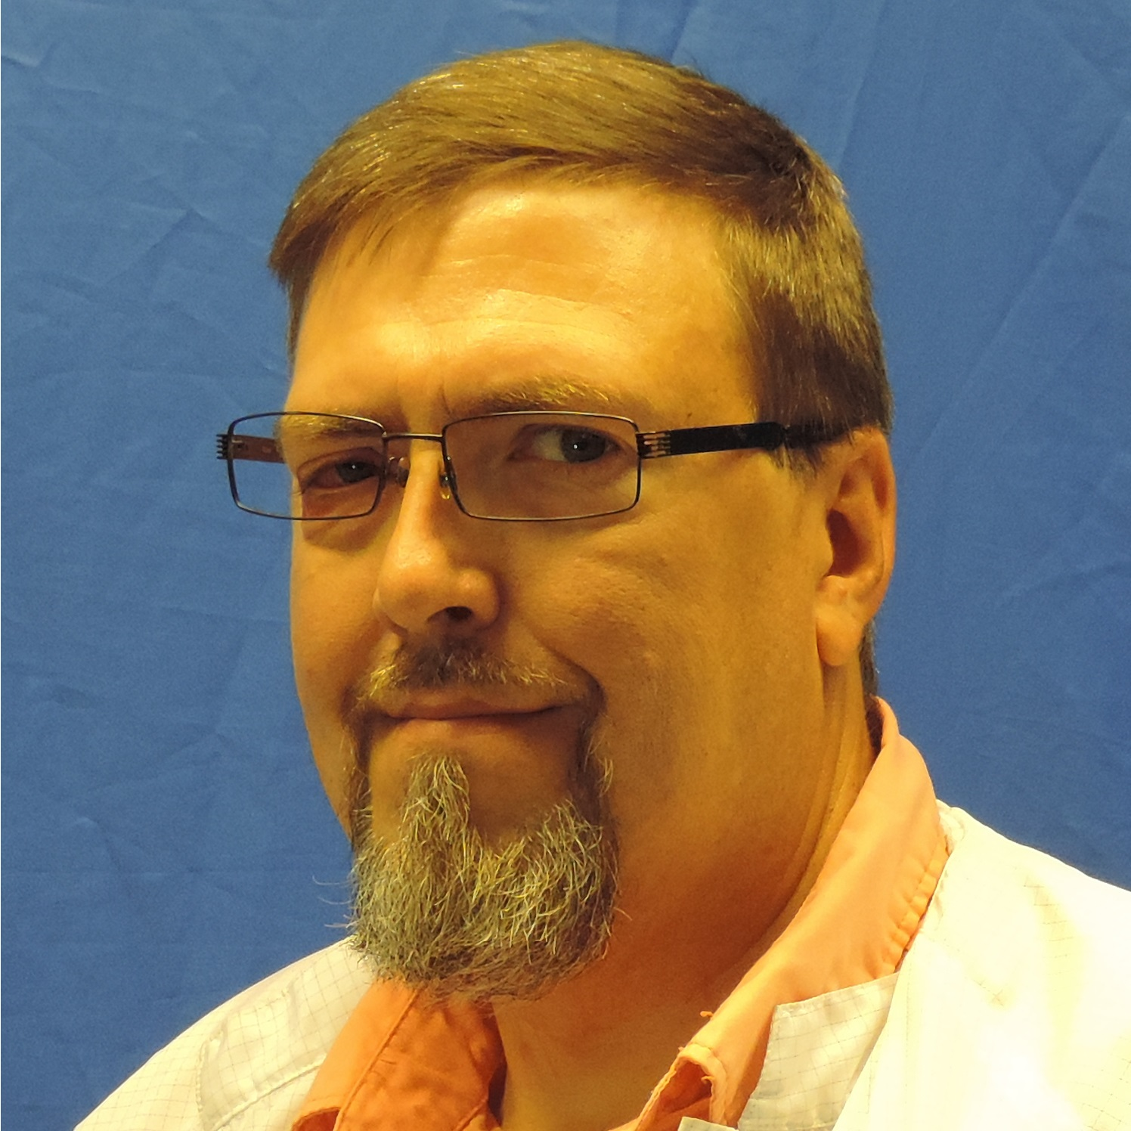
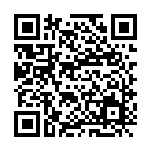
Anthony Day (Physics BSc)
Detector Development Scientist
Pacific Northwest National Lab (PNNL) – Richland, WA
Why Physics?
Anthony was a curious kid, always wondering how things work. Physics tied everything together.
“In high school I was interested in applied science, computers, and electronics,” Anthony says. “[My physics instructor] expanded my interest even further. Then he showed me how physics could relate those interests.”
Anthony advises students to expand the background that physics gives you by being open to a variety of scientific areas and working with scientists in other disciplines.
“Having a varied toolbox of skills helped me to support amazing collaborations…fostering new and exciting career opportunities.”

Slide 10
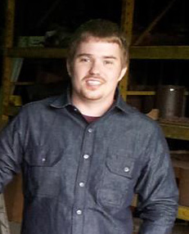
PHYSICIST PROFILE
Ian Young (Physics BSc)
Engineering Physicist Fermi National Accelerator Laboratory – Batavia, IL
Ian got interested in physics attending Minneapolis Community and Technical college. He transferred to the UMN, worked with particle physicists on building a new accelerator, and then an intern at a small industrial manufacturing company. Having completed his degree he joined Fermi Lab.
“I work with physicists, engineers and technicians to design, create and implement automation for various systems such as cryogenic controls and oxygen safety. I also work on many other aspects of the diverse array of experiments conducted here.”
Ian wasn’t sure whether he wanted to stop at the BSc or continue with his studies. He expected his physics major studies to be challenging as well as rewarding. He was nervous about his job prospects if he didn’t continue beyond the the BSc.
“But I found out that there are plenty of opportunity for employment with a physics degree. It seems that majoring in physics is a very focused degree, but in fact it allows you to be extremely versatile in your career choice. My studies gave me the mathematical, critical thinking and never-give-up attitude to tackle every task.”

Slide 11
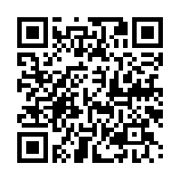
Kathy McCormick (Physics PhD)
Subject Matter Expert, Customs and Border Protection
US Department of Homeland Security – Washington, DC
Why Physics?
Kathy always loved science, but it was a high school physics class that changed Kathy’s college plans to physics.
“Physics seemed to be the most fundamental of the sciences that I had studied. [Physics gives] you insights into many different fields.”
Now, Kathy is a subject matter expert for US Customs and Border Protection (CBP). She defines regulations and tests the sensitivity and functionality of new equipment which will be deployed to field sites. This equipment is used to guarantee the security of cargo entering the United States, a process which includes scanning for illegal radioactive material.
“During my thesis research, I had the opportunity to work on many different types of radiation detection equipment and perform analysis on my data,” says Kathy. “I use those skills a lot today.”

Slide 12
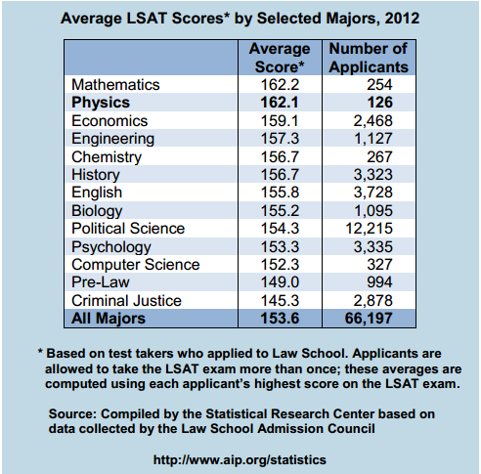
Did You Know?
Planning a Law Career? Did you consider a Physics Major?
Physics majors outperformed many other majors (including Pre Law, Political Science, and Criminal Justice majors) on the 2012 LSAT exam.
Furthermore, many law careers—such as those in Patent Law—require an advanced degree in sciences such as physics.
So, a physics degree is a great way to prepare for careers in law
Learn more: aip.org/statistics
Credit: based on Physics Insight slide from the APS

Slide 13
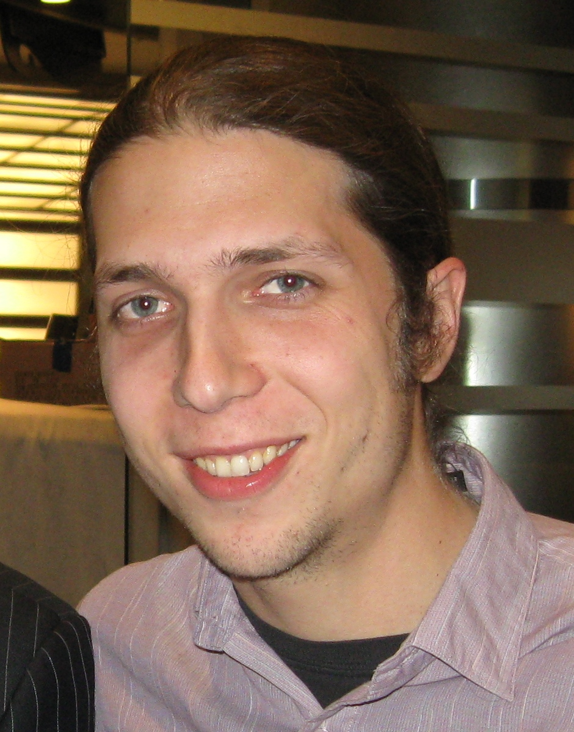
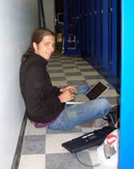
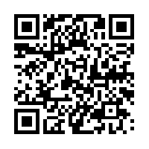
Sam Wurzel (Physics MSc)
CEO and Co-Founder Octopart, Inc. – New York, NY
Sam’s “entrepreneurial spirit” arose out of frustration as a physics graduate student: searching for parts in huge paper catalogs!
Recognizing a need in the science community for a better way to find parts, and inspired by an essay on startups, Sam teamed up with a friend to create an online search engine: Octopart.
Today, Octopart’s 700,000 users can search for 30 million parts from thousands of suppliers! Sam owes his success in part to his physics training:
“Starting a company is similar to doing physics research,” he says. “Both have the potential to impact people’s lives, and both require problem solving and creative thinking.”
Sam “in the trenches” as a young entrepreneur

Slide 14
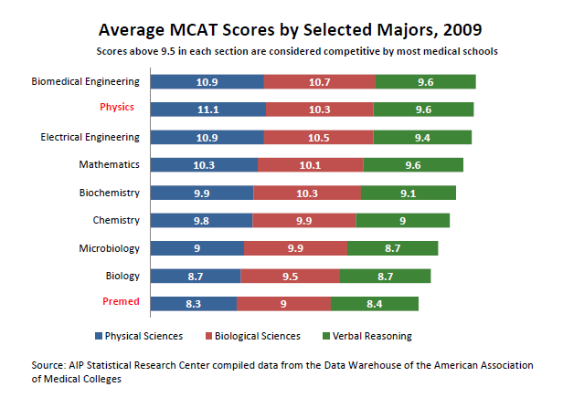
Did You Know?
Physics BSc Scores Highly on the MCAT
For many years, physics majors have been out-performing other majors (including pre-med) on all three sections of the MCAT.
Physics majors also account for less than 1% of individuals taking the exam…
Learn more: aip.org/statistics
Credit: based on Physics Insight slide from the APS

Slide 15
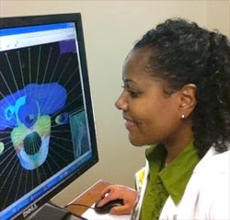
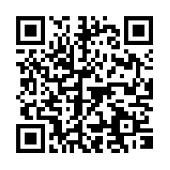
Christina Barrow (Medical Physics)
Medical Physicist Department of Veteran Affairs – Baton Rouge, LA
Why Physics?
Christina had an early interest in math and science.
“I was always tinkering around the house as a child, trying to figure out how and why things worked.”
Christina started off as an electrical engineer, but wanted her work to impact medicine. So she decided to study Medical Physics in grad school.
Christina now works at the Department of Veterans Affairs in Louisiana.
Her job is to treat cancer patients with radiation therapy. She ensures they receive the correct dosages of radiation—those which destroy tumors and do minimal damage to healthy tissue.

Slide 16
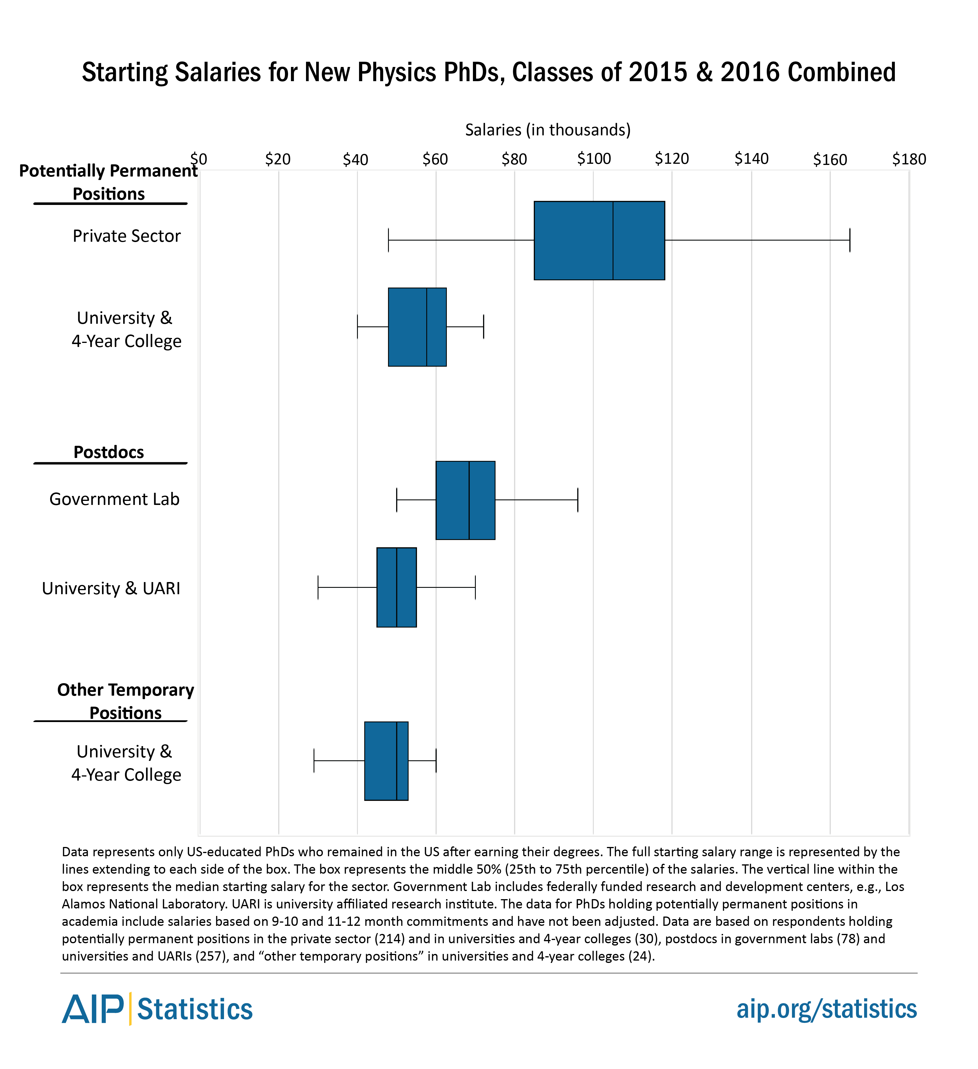
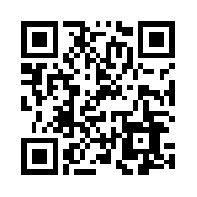
Physics PhD Have Earning Power!
According to the AIP statistical research center, Physics PhDs starting in the private sector earned on average $110K!
Since 1971, the Private Sector has been the single largest employment base for Physics PhDs*.
There are many high-paying and interesting private-sector careers that you can pursue with a Physics PhD!
* according to the NSF Survey of Doctoral Recipients, 1971-2006

Slide 17
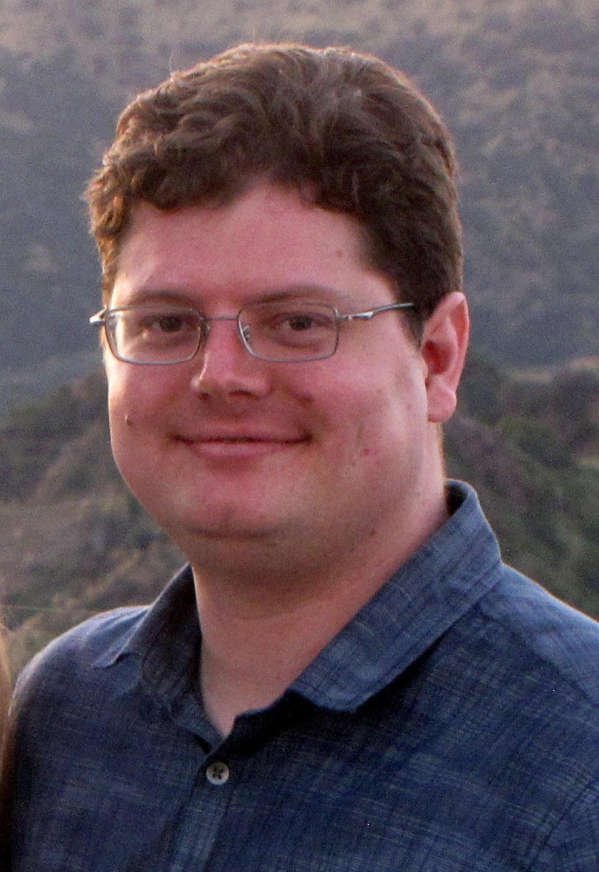
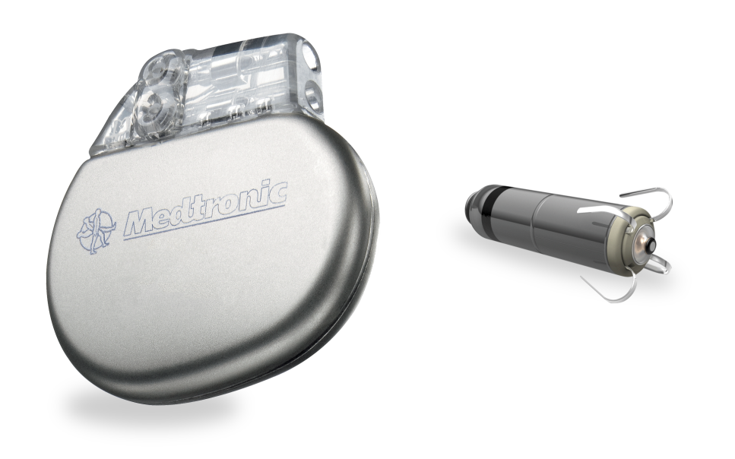
PHYSICIST PROFILE
Mark Madland (Astrophysics BSc)
Manufacturing Process Engineer Medtronic - Brooklyn Center, MN
Mark always liked to figure out how things worked. Enjoying all sciences, an outstanding senior year high school physics experience led him to an astrophysics major in college.
“A technical foundation in physics and ability to comprehend complex problems allowed me to get a job that wasn’t asking specifically for a physicist.”
As an engineer making medical devices, Mark gets to determine and improve upon how they are made. He also uses data gathering and critical thinking to get at root causes of manufacturing issues and to improve the processes.
“The projects I work on are sometimes like my undergraduate physics laboratory classes. Hypothesize, experiment, report. Almost every day I use skills I learned in school such as how to take, analyze and report data.”
Pacemakers - Medtronic, PLC.

Slide 18
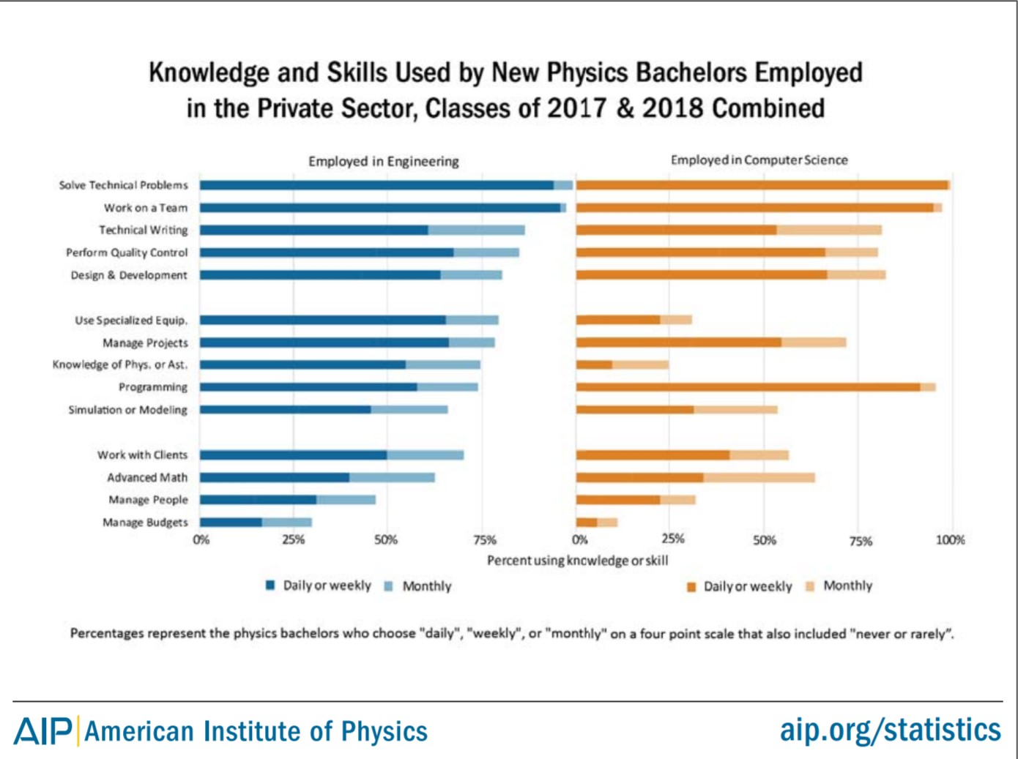
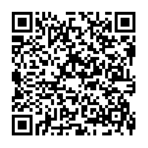
Physics Gives you Major Skills!
Roughly half of 2007 physics BSc graduates found initial employment in the private sector in Engineering or Computer Science fields.
Of these, nearly 100% stated that the problem solving abilities they gained as a physics student were useful in their jobs.
Other useful skills included technical writing, programming, and teamwork.
So, a physics training gives you skills that are applicable to a variety of career paths.

Slide 19
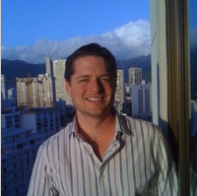
PHYSICIST PROFILE
Matthew Abroe (Physics PhD)
Portfolio Manager Black River Asset Management – Minneapolis, MN
Matthew, who enjoyed mathematics and his high school physics class, decided to major in physics in college, which ultimately led to his PhD.
After graduate school, Matthew got a job as a quantitative analyst, where he built analytical tools for finding trading opportunities in global financial markets.
“A friend from grad school got a job at a hedge fund, which is how I learned about finance as a possible career path. While applying for post-docs I also sent my resume to Black River, which led to a job offer.”
After several years as an analyst Matthew moved into a portfolio manager role who makes investment decisions. He now manages a team of 8 investment professionals who allocate capital to large domestic and international investors.
“The analytical lessons I learned doing physics research were crucial in developing the systematical tools I use for analyzing financial markets.”
Learn more: black-river.com

Slide 20
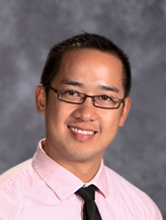
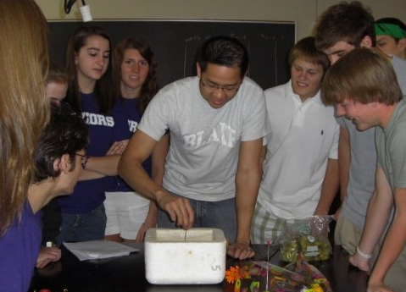
PHYSICIST PROFILE
Jeff Trinh-Sy (Physics BSc)
High School Teacher The Blake School, Minneapolis, MN
After several on-the-spot job offers, before he even earned his degree, it was clear to Jeff that the mindset and perspective that physics offers is incredibly valued by various fields of the workforce. After two summers of working with students, though, he found that teaching is a path that brought him fulfillment and meaning.
“Every day I get to play with, study, and teach physics. More importantly, though, I get to give people a glimpse of how I see the world and beyond. That opportunity to see those sparks of light is absolutely invaluable.”
As an educator Jeff has the freedom to develop curriculum and even entire classes that resonate with him. He sees powerful connections between physics and other fields of human endeavor.
“It’s all about taking the never ending life lessons that I pick up everyday and teaching them through the language of physics, math and science in general. It doesn’t take long for students to see how limitless these tools really are.”

Slide 21
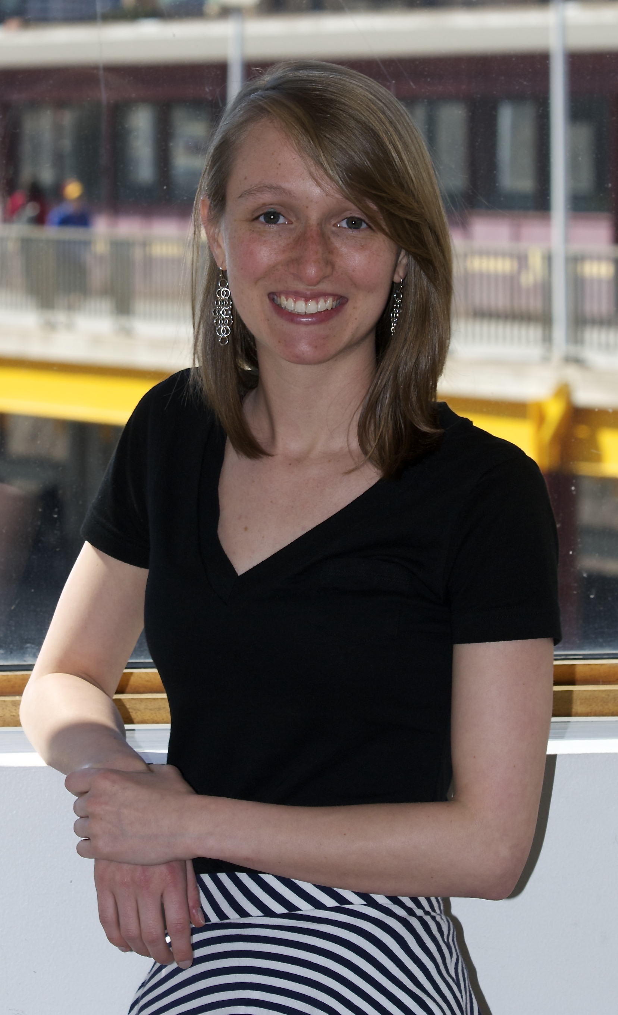
PHYSICIST PROFILE
Kelly Stifter (Physics BSc)
Physics Graduate Student Stanford University, CA
Kelly came to the University of Minnesota intending to major in astrophysics. She was always captivated by the stars and the universe.
But part way through her studies she switched to experimental physics and among other things helped build hardware for detectors at the European CERN accelerator.
“I found that the part I enjoyed most most was tinkering with all of the hardware. I like to build things, especially when these things are used to discover how the universe works at the most fundamental level.”
Serving as a Teaching Assistant Kelly also found that she enjoys teaching and sharing physics with others, and decided to continue as graduate student, which may lead to an academic career.
“Physics is my passion. It is incredible that I will be paid to live this dream every day. I look forward to working with different groups at Stanford while I find my future path.”

Slide 22
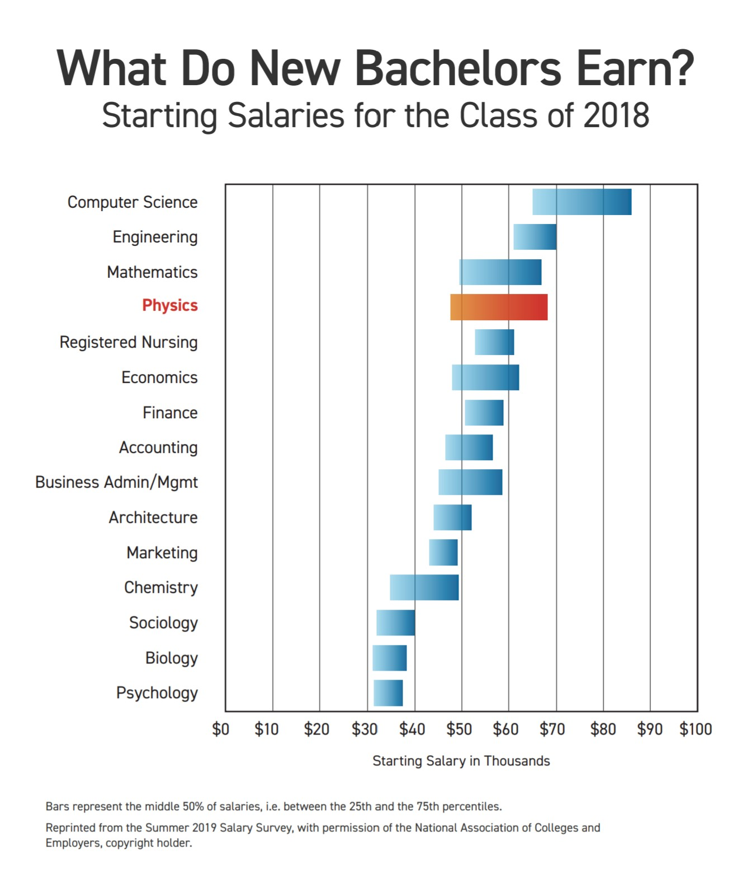
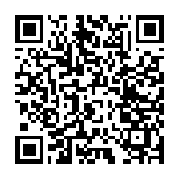
A Physics BSc Really Pays!
A physics bachelor’s degree now ranks higher in starting salary than many other technical fields (including mechanical engineering).
The typical starting salary for a physics bachelor degree has increased by nearly $20,000 since 2003.
So, physics is an excellent choice for those interested in a degree with high earning power!

Slide 23
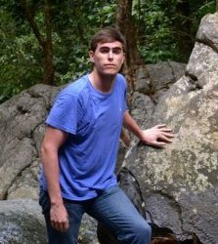
PHYSICIST PROFILE
Evan MacAyeal (Physics BSc)
Quantitative Analyst Black River, MN
Evan’s first physics class in high school, during his junior year, finally gave him a real sense of direction and it led to majoring in physics at Carleton College (MN) .
He got involved in gravitational-wave research during his freshman year and continued this research while taking the usual assortment of classes. But then he changed direction:
“Dating my future fiancé, and thinking about a family and what’s important for me, I worked hard to complete my BSc in three years. Then I did a 1-yr MSc degree in financial engineering at Columbia . ”
Using his degrees and alumni connections Evan quickly found work at a financial company in the Twin Cities.
“Physics teaches you to think. I remember very little of the formulas and theorems, but I use the ability to take something complex and boil it down into a simpler, toy version. Physics also taught me applied math, programming, logic, expository writing, critical thinking, but most importantly it taught me intellectual honesty, perseverance, and to trust empirical evidence more than bravado and swagger.”

Slide 24
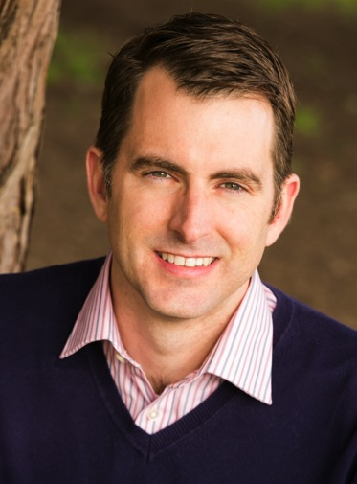
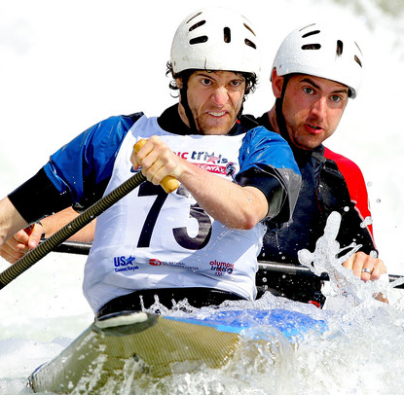
PHYSICIST PROFILE
Bryant Grigsby (Physics BSc)
Vice President of Operations and New Product Introduction Lumenetix – Scotts Valley, CA
Bryant first considered a business major but found it lacking in technical challenges. He switched to engineering, but having taken a physics intro class he was drawn to physics because it provided a little bit of understanding of everything.
“I expected that getting a job as an engineer or scientist would be easy, but it wasn’t. Perhaps having an advanced degree or minoring in EE or ME would have made it easier.”
Physics gave Bryant the broad background necessary to lead a multidisciplinary science and engineering team dealing with electronic design, optics, thermal and stress analysis, statistics, and software.
“When you lead a large engineering team you are asked to make decisions that will greatly affect what you are designing, often in an area that you have never worked in. A BS in physics gives you a broad enough understanding in everything such that, if you have any decent problem solving skills, you can interpolate and come to a sound decision.”
Bryant and partner in an Olympic canoe team trial

Slide 25
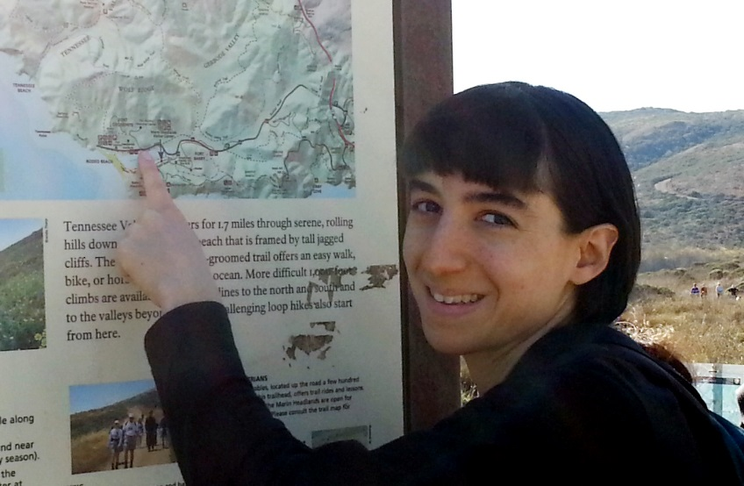
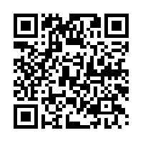
Brenda Rubenstein (Physics PhD)
Postdoctoral Researcher
Lawrence Livermore Nat’l Lab – Livermore, CA
In college, Brenda looked for a career path that would allow her to make a positive change in the world. She was struck by the power of simple ideas in physics.
“A single person’s efforts can amount to something profound. That notion is what initially drew me to physics and what continues to do so today.”
Today, Brenda works as a postdoctoral researcher at Lawrence Livermore National Lab (LLNL). Brenda says she enjoys working in a national lab: after graduate school, she wanted to balance her time between research and mentoring opportunities.
“Lab scientists get the best of both worlds in this regard – while they often mentor other scientists, they still have the opportunity to conduct their own day to day research.”

Slide 26
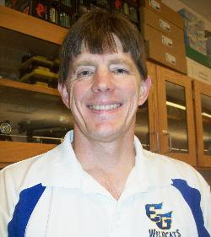
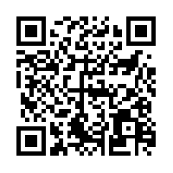
Thomas Hefner (Physics BSc)
High School Physics Teacher
Eastern Guilford High School – Gibsonville, NC
Thomas took a year off after high school, and found himself working a “mindless job” with a lot of time for self-reflection. He decided to pursue a degree in physics and secondary education because he wanted a challenging, meaningful career.
“I always had an interest in the sciences and I wanted to have a career that gave something back to society.”
Now, Thomas is a high school science teacher. He teaches various levels of physics, but also teaches other science classes. Thomas says that his physics background gave him the fundamental knowledge and logical thinking skills that make him so versatile.
“I have found myself having an easier time teaching other fields and being able to draw links back to the foundations of… science, which is physics.”

Slide 27
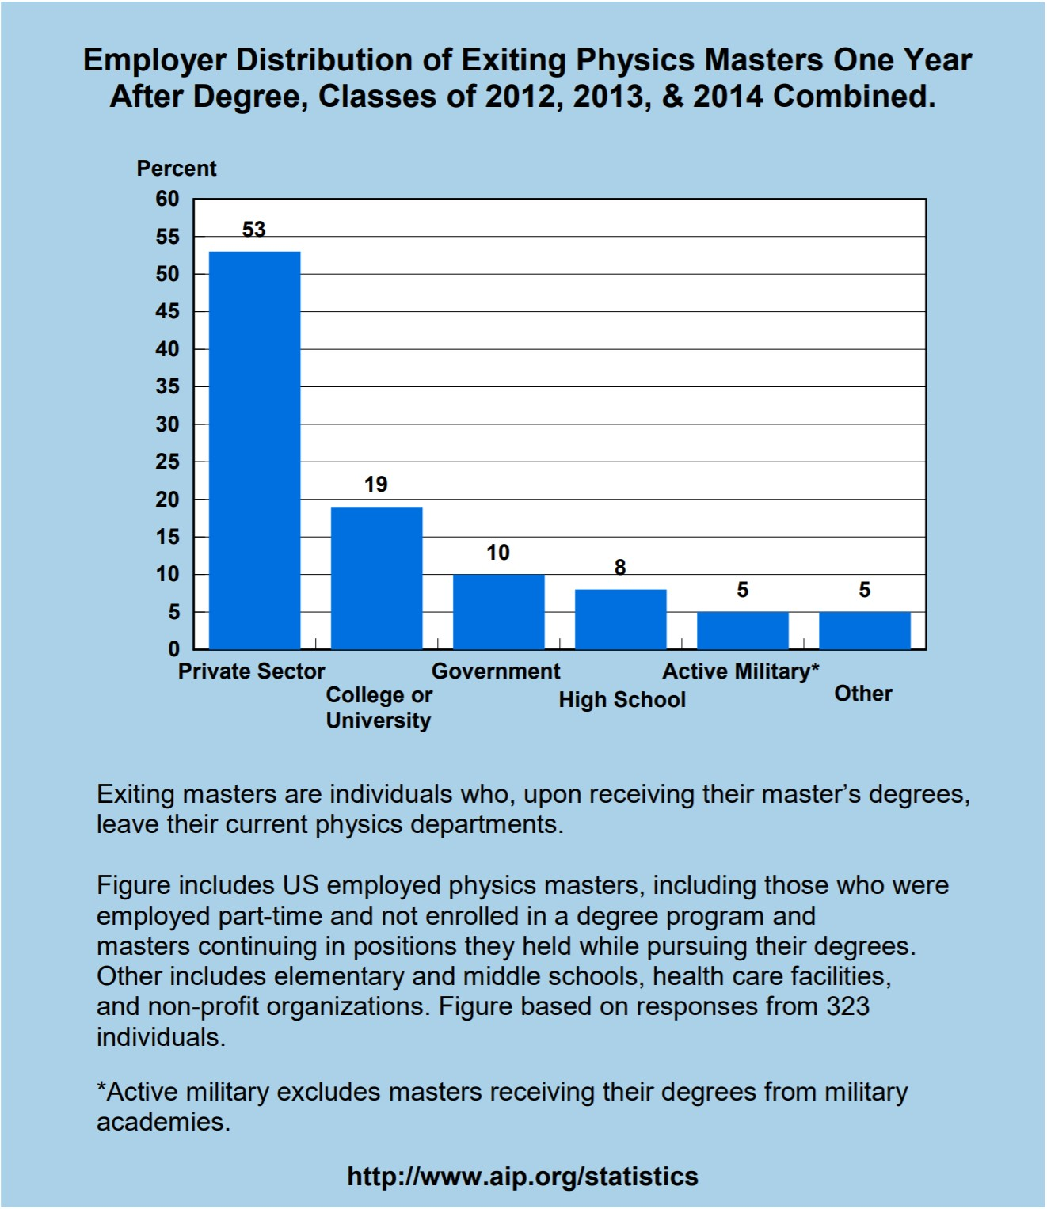
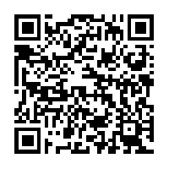
A Physics Masters Opens Doors!
Between 2012 and 2014, approximately one-half of new Physics Masters in the US were employed in the private sector
Almost one-fifth were continuing in a position they held prior to receiving their degree.
Physicists working in the private sector also reported working in a variety of scientific areas.
So, a Physics PhD can lead to well-paid employment, in a variety of fields.

Slide 28
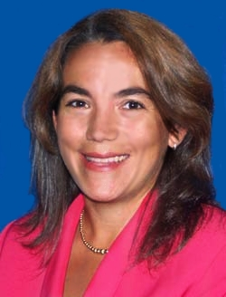
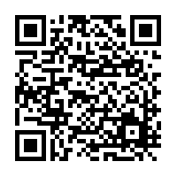
Lynett Rock (Physics MSc)
Science and Physical Education Department Chair
Connors State College – Warner, OK
Why Physics?
Lynett was interested in science and math, but a Minority Scholarship from APS encouraged her to major in physics. After her first physics class in college, she knew she had made the right choice.
“Everybody has something that they get to be very good at, and physics just happens to be my area.”
After she earned her master’s degree in physics, Lynett taught high school physics. She soon accepted a position teaching at the Connors State College, in her home town. Lynett now chairs the Science Department, but she still teaches physics and math classes.
“I believe teaching the next generation has a huge impact on the future,” she says.

Slide 29
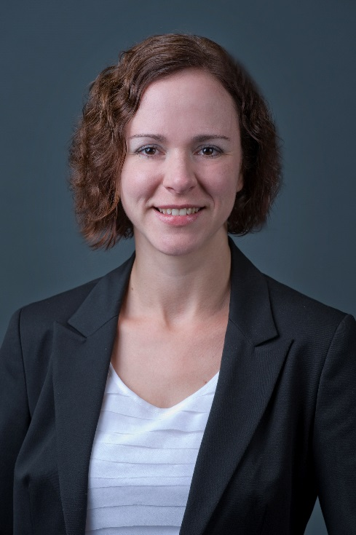
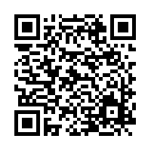
Meghan Anzelc (Physics PhD)
Analytics Manager
CNA Financial – Chicago, IL
On the recommendation of a professor, Meghan decided to try a physics course in college. While it was not an easy class, she really enjoyed the material and decided to minor in physics.
“A summer research internship got me hooked on experimental science, and pursuing that interest is what led me to complete a B.S. in physics and then go on to graduate school.”
Meghan’s first job after graduate school was in predictive modeling at an insurance company. Now, she is the Assistant Vice President of Pricing for the small business segment at CNA Financial.
“My current role in the Actuarial Department gives me more exposure to the underwriting side of [CNA] and how the business of insurance is run.”
View the webinar about Meghan’s career!
Visit www.aps.org/careers/guidance/webinars/selfadvocate.cfm

Slide 30
PHYSICIST PROFILE
Paul Kelley (Physics BSc)
Program Manager – Hardware Technologies,
Apple, Cupertino, CA
Paul decided to major in physics because he wanted to understand how things worked and expected that the concepts being taught would provide the explanations.
After graduation he got a job at 3M measuring the optical properties of components for consumer electronics. Later he worked as an application engineer.
“It seems strange to say but getting my first job wasn’t that hard. I was lucky to have some connections with friends at 3M, which has many other physics majors in various divisions. In 2009 I moved to CA to work for Apple, contributing to the iPod, iPhone, and Apple Watch projects.”
Paul excelled in some physics classes (Quantum Mechanics), others he found tough (Thermodynamics); he wasn’t a ‘straight A’ student.
“Some students are discouraged by getting low grades in physics classes; some think that they are not smart enough. I encourage those interested to stick with it, and enjoy the satisfaction of understanding the principles of how things work. Physics has been the foundation for my career in product development.”

Slide 31
The Vector is a monthly email for undergraduate members of the American Physical Society, and includes helpful topics such as:
Career advice
Resume writing techniques
Tips for applying to graduate school
…and much more!
Undergrad students at the 2012 APS March Meeting
The Vector also highlights information about opportunities and resources specifically designed for undergraduate physics students.
Learn more: www.aps.org Keyword: UNDERGRAD

